Slide 1

Modelling in Java

Slide 2
Me
George Svarovsky
Technical Director @ IDBS
gsvarovsky@idbs.com
http://uk.linkedin.com/pub/george-svarovsky/35/999/465
Notes:
15 yrs
O-O
50,000 scientists
2006 SEM

Slide 3


Slide 4
This
Modelling
Model-driven development
Java
JCurry
JSizzle
Notes:
Worked example
Modelling: state-based
Model-driven: not MDD
Java: tools & implementation
JCurry: tangentially; functional programming
JSizzle: exemplar, scratching surface, history

Slide 5

You
Z?
UML?
Other..?
Notes:
New system – [requirements/stories] – [domain analysis] – specification – state model (begin terminology)
-----
Number happy, unhappy
Behaviour vs state modelling
What is wrong?

Slide 6
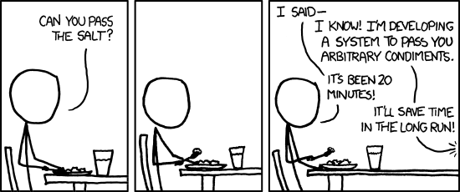
http://xkcd.com/974/

Slide 7
Solutioneering

Slide 8
UML
Notes:
Constraints? Number of cells = product of items
Could say categories + items define cells
Where to put values? Valid addresses

Slide 9
Z
Notes:
Notation
-----
Go to demo

Slide 10
Java
Reference equality
Nulls
Mutation
Default visibility
Procedural
Informal invariants
Painful to initialise
Notes:
Dragging around Java semantics

Slide 11
JSizzle
Value equality
No nulls
Everything public & final
Declarative
Invariant checking
Generated initialisers
Notes:
Initialisers: allow animation

Slide 12
Instrumentation
Lots of options (it’s Java!)
Abstraction gap
Ad-hoc animation
Unit tests
Notes:
Options: in mapping code (e.g. abstract list)
Gap: Size of QAPI/Impl vs. model
Also features (e.g. groups)

Slide 13
Z Influence
State transitions
Promotion
Export to Z
Notes:
Z: Designed to be alike;
Transitions: behavioural
Export -> model checking

